Slide 1
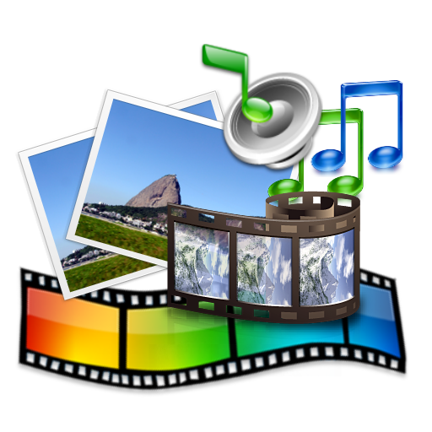

Logo
Class 7
Lab 24

Slide 2

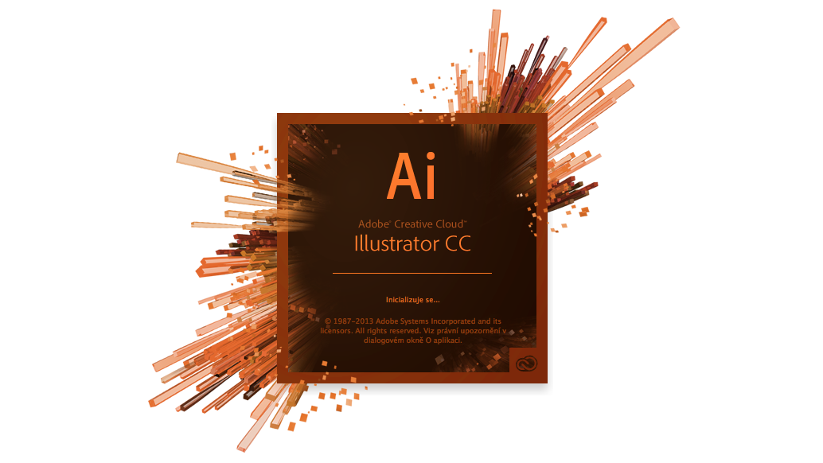
Adobe Illustrator
The most popular logo making software is Adobe Illustrator
Notes:
Notes to presenter:
Description of what you learned in your own words on one side.
Include information about the topic
Details about the topic will also be helpful here.
Tell the story of your learning experience. Just like a story there should always be a beginning, middle and an end.
On the other side, you can add a graphic that provides evidence of what you learned.
Feel free to use more than one slide to reflect upon your process. It also helps to add some video of your process.

Slide 3
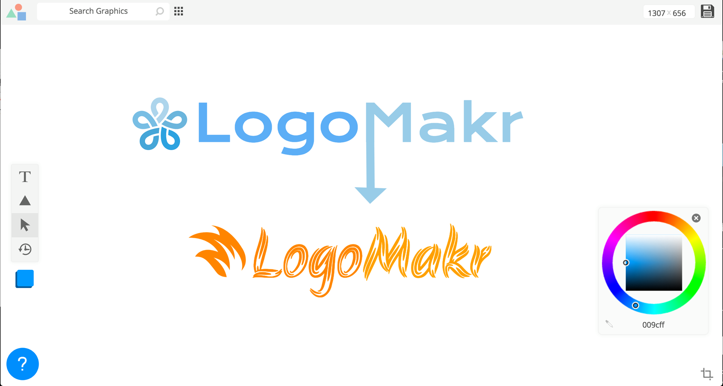
https://logomakr.com/
We will use an online app to make our logo
Notes:
Notes to presenter:
Description of what you learned in your own words on one side.
Include information about the topic
Details about the topic will also be helpful here.
Tell the story of your learning experience. Just like a story there should always be a beginning, middle and an end.
On the other side, you can add a graphic that provides evidence of what you learned.
Feel free to use more than one slide to reflect upon your process. It also helps to add some video of your process.

Slide 4
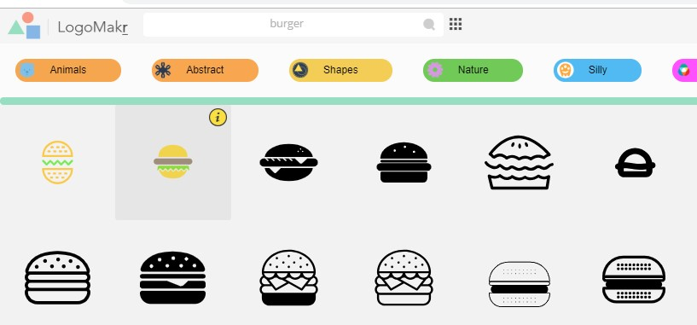
Creating Logo
Go to logomakr and search burger

Slide 5

Creating Logo
Add text with suitable font and color

Slide 6
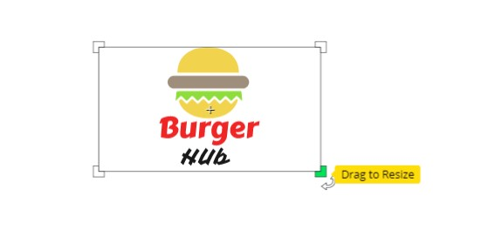
Creating Logo
Add text with suitable font and color

Slide 7
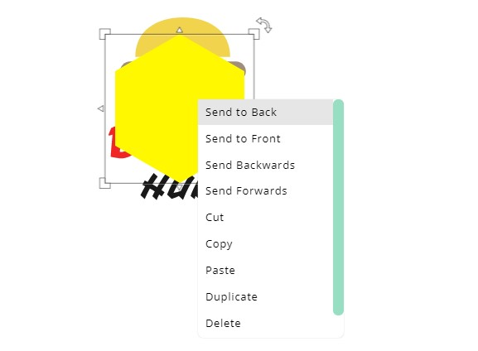
Creating Logo
Add a polygonal and send it to back and resize it

Slide 8
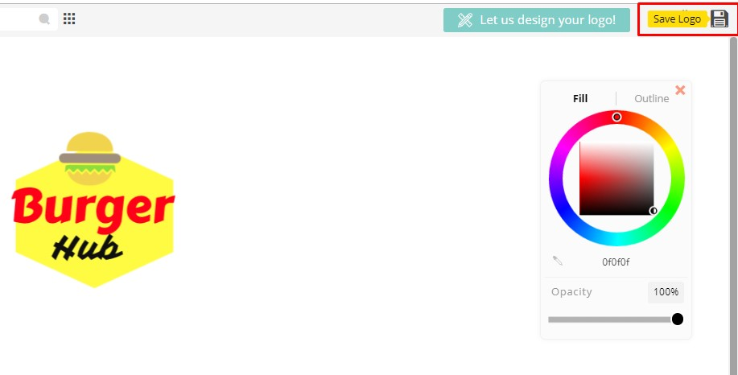
Creating Logo
Change opacity if needed, make transparent background then save it

Slide 9

Creating Logo
Your logo is ready to use

Slide 10
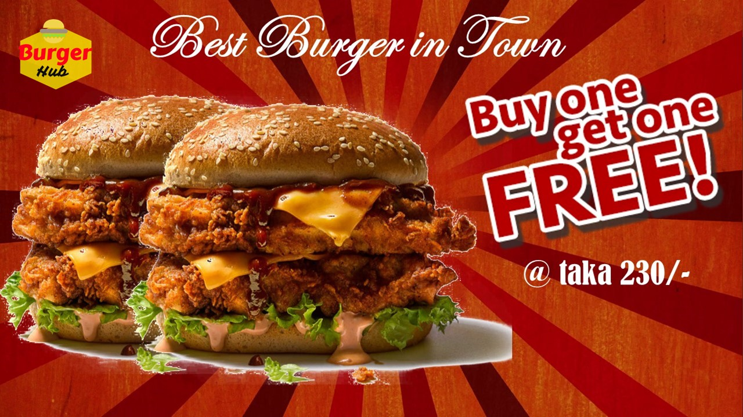
Open your previous poster with MS PowerPoint insert your logo and export as JPEG format

Slide 11


